Slide 1
Imarticus Learning
CP 2 Evaluation
Name: Prathamesh Ambre(PGA-16)
Topic: Vegetable Type Prediction

Slide 2
Aim Of This Project
Main aim of this project is to predict the correct Vegetable Name using Deep Learning Techniques like Convolutional Neural Network or CNN and Visual Geometry Group VGG16.

Slide 3
Data Set
Size of training set: 18000 Images
Size of test set: 45 Images
The vegetables that are chosen for the experimentation are: bean, bitter gourd, bottle gourd, brinjal, broccoli, cabbage, capsicum, carrot, cauliflower, cucumber, papaya, potato, pumpkin, radish, and tomato. A total of 18045 images from 15 classes are used, where each class contains 1400 images of size 224×224 and in *.jpg format.

Slide 4
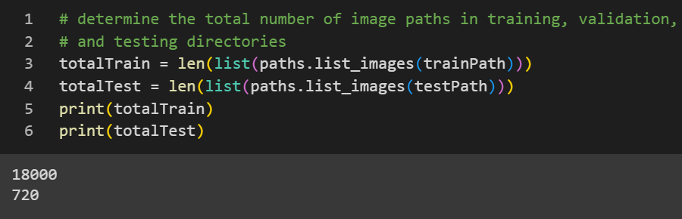
VGG16 Model
Base Model of VGG16
Train Test Split

Slide 5
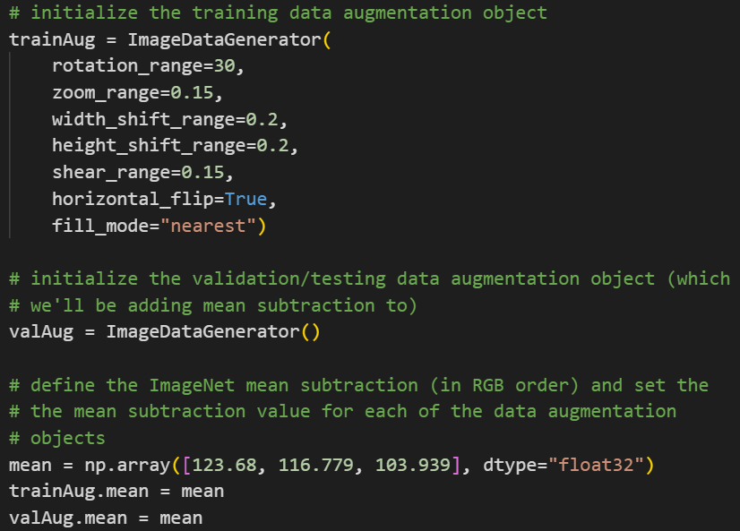
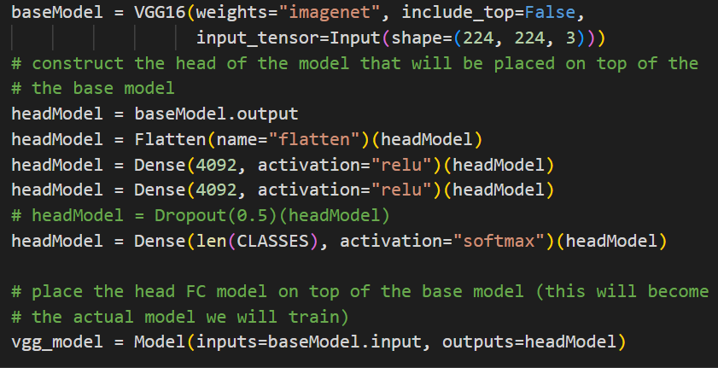
Augmention on Train data
ANN Part of VGG16

Slide 6
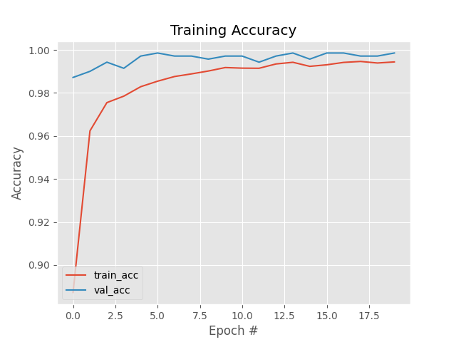
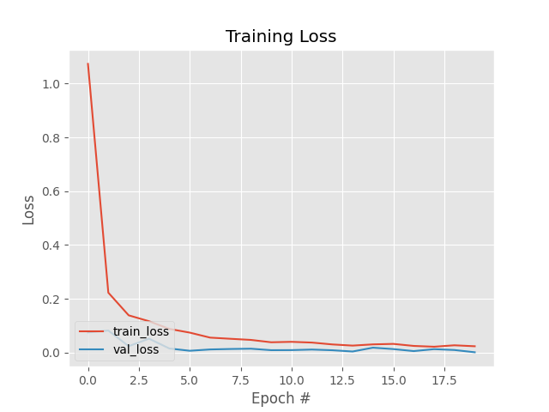
Accuracy and Loss Graph

Slide 7
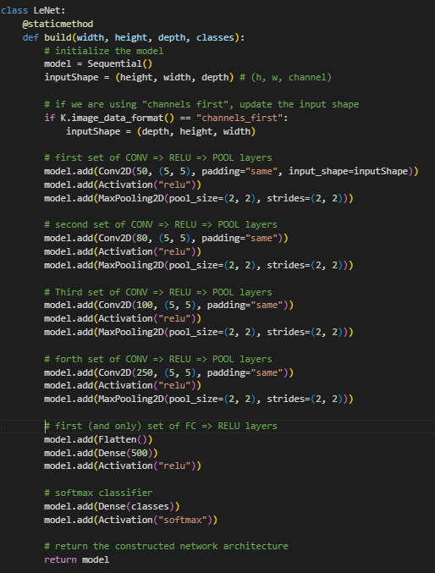
CNN Model
In this CNN Model, there are four set of Convolution, Activation(relu) and Pooling(Max Pooling).
One Set of ANN model, with Flatten layer, Dense 500 neurons(Perceptron's) and Activation(relu) in hidden layers.
In out put layer Activation function is SoftMax.

Slide 8
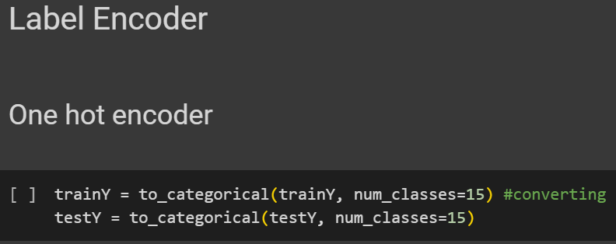
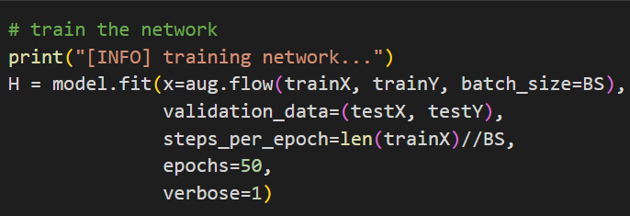
Label Encoding and Fitting the model

Slide 9
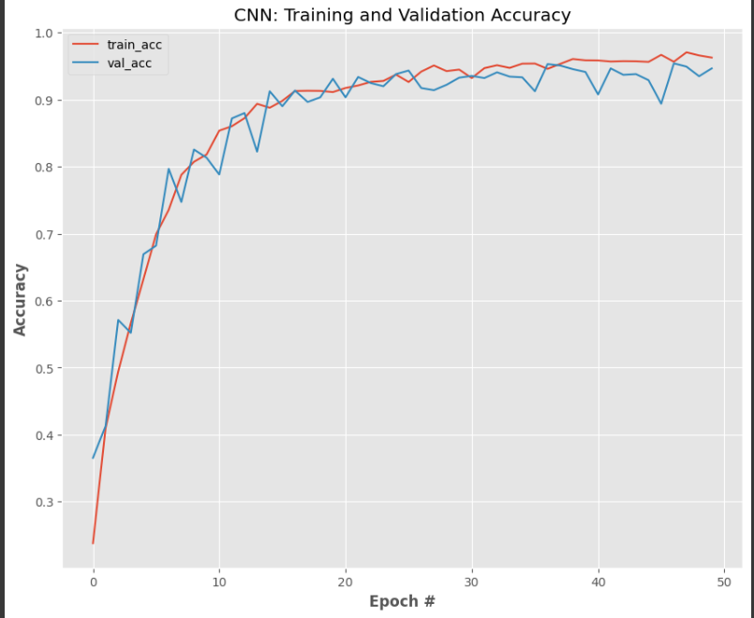
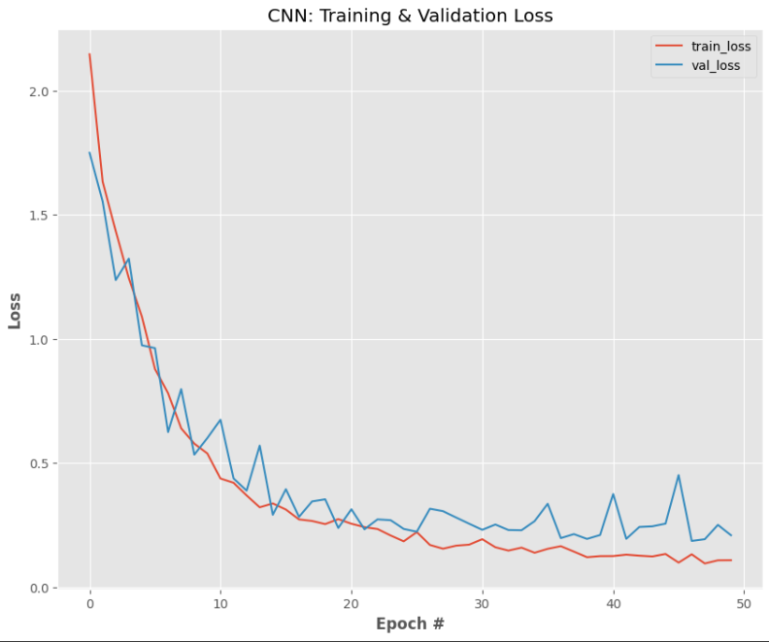
Accuracy and Loss Graph

Slide 10
Final Conclusion
In VGG16 Model, is Overfitting, while training it is giving me good accuracy but, on new data model is note recognizing the class properly.
In CNN Model, Model is doing well on new data.
In this CNN is doing well as compare to VGG16.

Slide 11
Thank You
Any Questions?

